Slide 1
INTRODUCTION TO MACHINE LEARNING
V.K.JAYARAMAN
SAVITRBAI PHULE PUNE UNIVERSITY

Slide 2
Learning methods

Slide 3
Supervised or Unsupervised
Unsupervised
Supervised

Slide 4
Supervised or Unsupervised
Unsupervised : Provided a set of features algorithm groups data into clusters ( does not require class information)
Supervised : Employs class label information of some instances to build a model. Model is validated employing unseen data

Slide 5
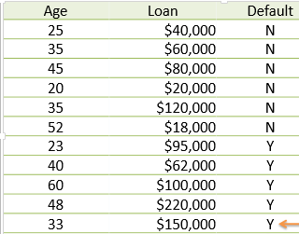
Credit Assignment Data

Slide 6
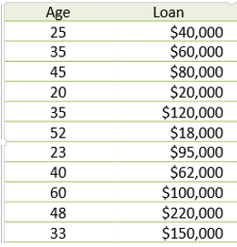
Unsupervised Classification
Algorithm will cluster the data points into groups
Input
Yes
No
Class information need not be provided

Slide 7
Supervised Classification
Input
ordered
disordered
Algorithm will be trained on a set of given data points.
This algorithm will classify unseen data points into classes
Class information is need for training

